Slide 1
Lymphatic system
The main function of lymphatic organs are :
1-defence:protect the body against foreign substances and bacteria.
2-fluid balance :lymphatic organs maintain the fluid balance in the tissue which is called “lymph”..which is the fluid that collecting from body tissue and return back to the blood circulation.
The composition of the lymph is (ions, water, proteins, enzymes, cells such as lymphocyte).

Slide 2
Lymphatic Tissue
The tissue in lymphatic organs which is composed of :
_Reticular tissue: which is reticular fibers as network of reticular cells.
_Free cells: are macrophage, plasma cells, and many lymphocyte.
These are the main cells in immune system, also there is a cell “antigen presenting cells” cells are (interdigitating cell) or (dendirietic cells).

Slide 3
Lymphocytes
_About 20% of the leukocytes in circulation.
_They are functional unit of immune system.
_These cells can recognize foreign antigen, they can distinguish self from non-self by their surface antigen receptors.
_Types of lymphocytes:
1-T-lymphocyte
2-B-lymphocyte

Slide 4
1_T Lymphocyte
_About 75% of circulating lymphocytes, (0-15) mm diameter.
_Their stem cells originate in bone marrow as immature and undifferentiated, they complete their maturation in thymus, proliferate as recognize as T lymphocytes (thymus-depended lymphocytes).
They are carried through blood stream to the spleen, lymph node and responsible for cellular immunity.

Slide 5
2_B lymphocyte
-thymus –in depended lymphocytes.
-5-15% of the circulating lymphoid pool.
-the main function of cells is the production of antigen-specific (immuno globulin).
-once activated B cell terminally differentiate in to plasma cells.
-are originate and complete their maturation in bon marrow then reach (lymph node, spleen) through blood circulation.

Slide 6
They are responsible for humoral -immunity through which it reach with antigens that stimulate it to produce plasma cells that secret antibodies (immunoglobulin) (A, G, D, E, M) in the body fluid.
_Lymphatic tissue are found in two forms:
1-Diffused lymphatic tissue.
2-Nodular lymphatic tissue.

Slide 7
_Diffused lymphatic tissue:
Means loose aggregation of lymphatic tissue mainly lymphocyte, no special organization but as in filtration of lymphocyte, also lymphatic nodules no capsule. this type found in ct of lamina properia of digestive tract, respiratory passage and urinary tract.
_Nodular lymphatic tissue:
Dense aggregation of lymphatic tissue mainly lymphocyte as organized structure called nodules” or “follicles” these follicles are about (0.2-1) mm in diameter, composed of 2 areas or zones:

Slide 8
1-Cenrtral area (germinal center)or(Secondary follicle):
Appears as lightly stain area composed of larger sized lymphocyte or lymphoblast, have large cytoplasm and pale stained nucleus mitoticly active where there is antigenic stimulation and any few formed cells will be add to peripheral area.
2-Peripheral area (primary follicle):
Appears as darkly stain composed of small sized lymphocyte with dark nucleus and little cytoplasm, these lymphocyte are densely accumulated.

Slide 9
_The lymphatic nodules is a variable either in size or position according to antigenic stimulation and they don’t develop before birth.
_Types of lymphoid tissue:
1-En Capsulated: contain capsule
Spleen, Thymus, Lymph nodes.
2-Un en capsulated (or partially en capsulated)
Tonsil, Peyer,s patches, Lymphoid nodules in digestive tract , respiratory tract, urinary and reproductive tracts.

Slide 10
Lymph nodes
Each lymph node is kidney shaped structure, various in size from (0.1-1.2) cm.
Located along the course of major vessels in (neck, thorax, abdomen, axilla) to the filter the lymph.
_Structure of lymph node:
-oval shaped surrounded by a dense fibrous c.t capsule.
-septa or trabeculea extend from capsule in to lymph node and divided the node in to in complete compartments.
-it has convex surface where afferent lymphatic vessels enter lymph node.
-at concave side, hillum is found.
-where blood vessels enter and leave lymph node, efferent lymphatic vessels leave the node through this hillum.

Slide 11
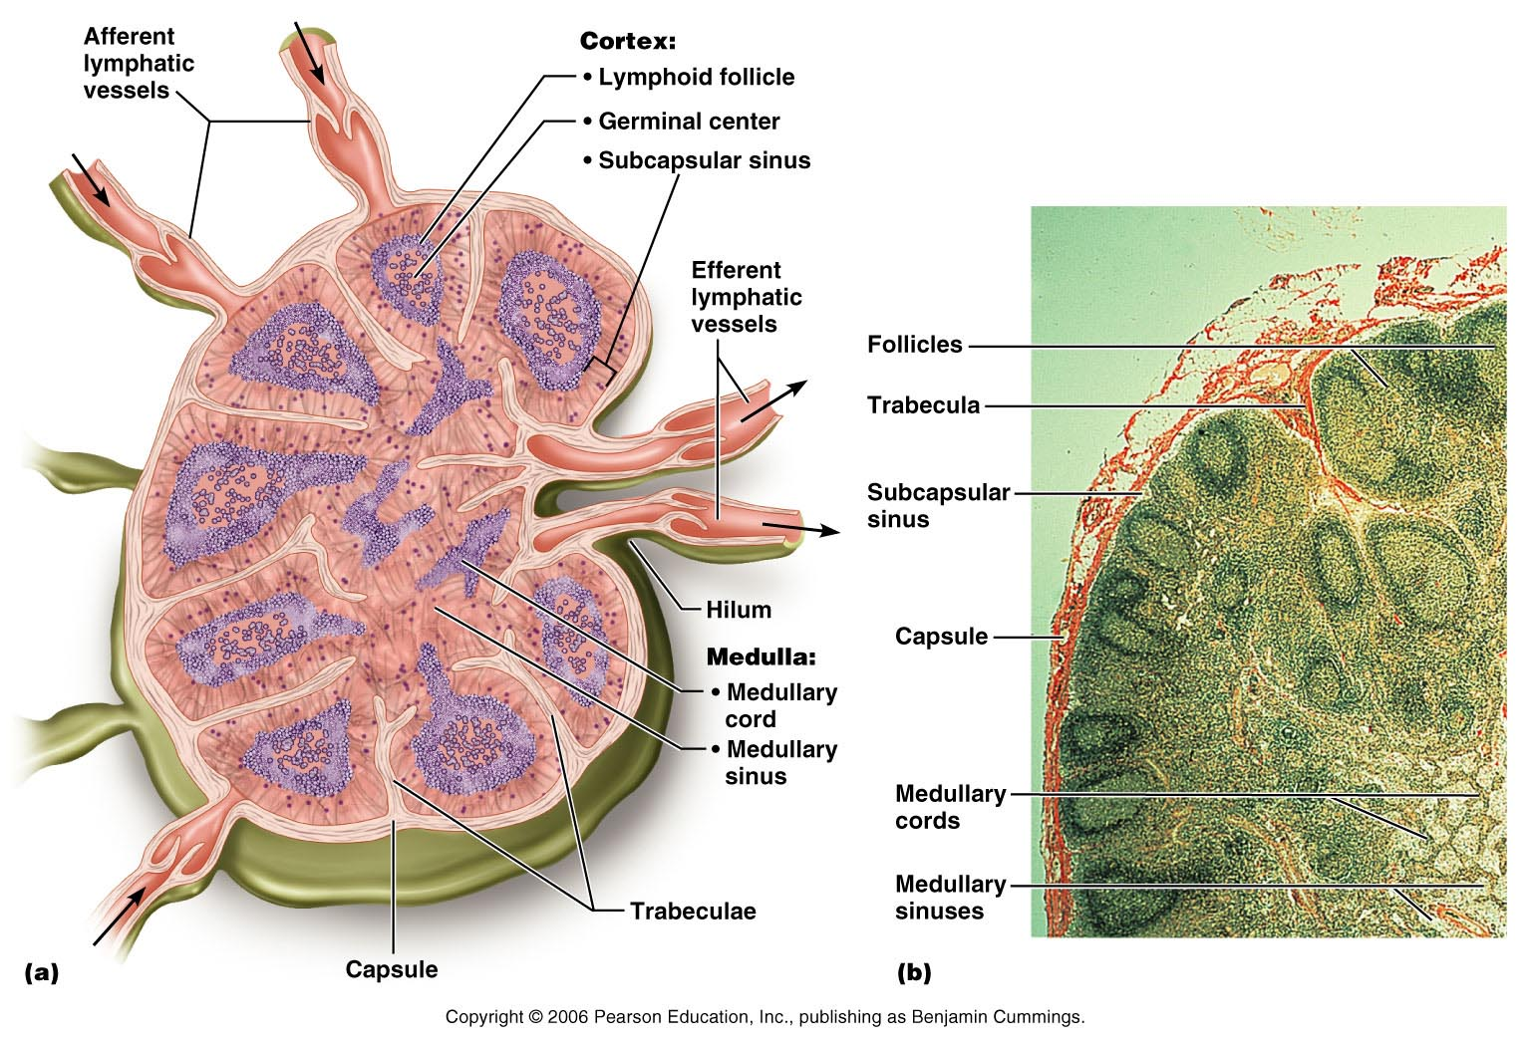
Structure of a Lymph Node
Figure 20.4a, b

Slide 12
Histological structure
Nodes have histological distinct regions:
1-cortex
2-Medulla
3-Paracortical area
_Cortex
Located beneath the capsule, composed of densely aggregation of lymphatic tissue, lymphatic nodules, some of them germinal center and some are diffuse lymphatic tissue may be found.

Slide 13
_Para cortical are
Its located internal to the cortex, between cortex and medulla, composed of diffuse lymphatic tissue (T lymphocytes), macrophage and antigen-presenting cell (interdigitating cells).
_Medulla
It’s the inner part of lymph node (lighter than corex) composed of :
A-Medullary cords
Aggregate of cells as cords B lymphocyte cell and few T cell, plasma cells, macrophages are embedded in reticular tissue.

Slide 14
B-Medullary sinuses
Are lined by continuous endothelium in complete layer of reticular cells, macrophages supported by reticular fiber.
Wall of sinuses allows free movement of lymphocytes between its endothelial cells.

Slide 15
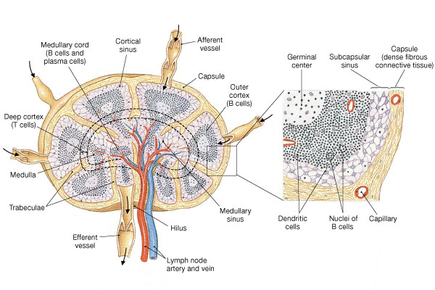
Lymph Node

Slide 16
Filteration of lymph through of lymph nodes:
Start from afferent lymphatic vessels found in capsule of lymph nodes…there are two capsular sinuses:
1.sub capsular sinuses 2.trabecular sinuses
-sub capsular sinuses..located beneath the capsule.
-the lymph run to trabecular sinuses and run with trabeculae in the cortex to medullary sinuses in medulla and then leave the lymph node through the hillum by efferent lymphatic vessels.

Slide 17
Afferent lymphatic vessels
Sub capsular sinuses
Trabicular sinuses
Cortex
Medulary sinuses
Efferent lymphatic vessels
Thoracic duct
Blood stream
Return to art

Slide 18
Function of lymph nodes:
1-filtration of lymph
2-defence mechanism through the immune response, through T-lymphocyte and B-lymphocyte , phagocyte of macrophage.
3-production of new lymphocyte through germinal center.

